Slide 1
The Wish List
Duncan Morrissey
Zach Lister
Ed Ryan
Ben Mitchell
Yiannas Karavas

Slide 2
App Overview
Competitors
Requirements
Development Stack
Our Process
App Preview

Slide 3
Overview
Aspects of Product
Wish List Registry
Create lists of gifts, share these lists with others
Create and manage groups of lists

Slide 4
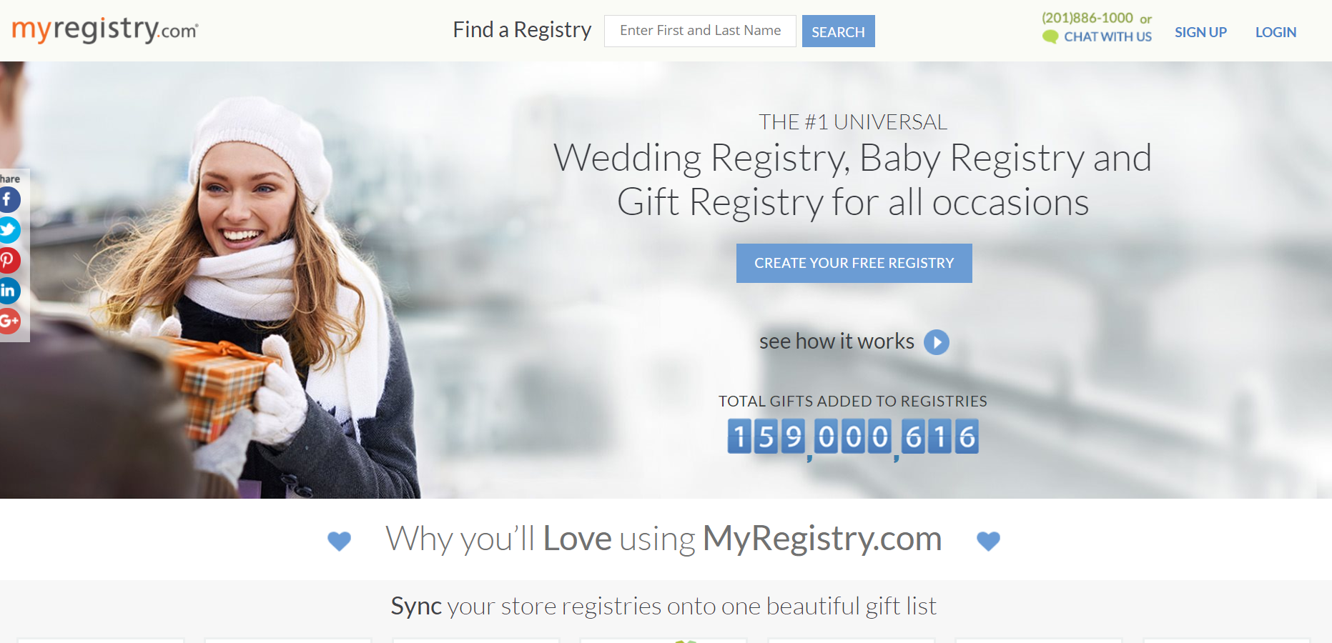
Competitors
Target, Walmart, Amazon all offer this as a service
Largest site: MyRegistry, integrates with these sites
Wishlistr, GiftBuster are free versions
We’re looking to strike a medium between the benefits offered by these different applications.

Slide 5
Essential Requirements
Users create/modify wishlists
Share wishlists/control who accesses
View someone else’s wishlist, navigate between wishlists shared with you
Seeing what items have been purchased on wishlists shared with you
Mark as purchased items on others’ wishlists

Slide 6


Ruby and App Setup
Ruby on Rails application
SQL Server via Tiny TDS
Bootstrap, JQuery, ERB (Embedded Ruby)
Deployment on AWS Beanstalk
MVC Architecture

Slide 7
Our Process
Scrum-like management
No daily standups
Planning and Retro meetings
General QA plan
Documentation
Review/Testing
Bug Tracking

Slide 8
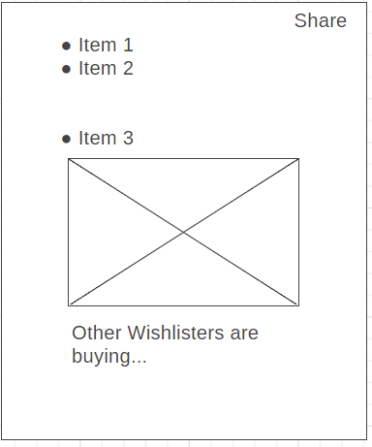
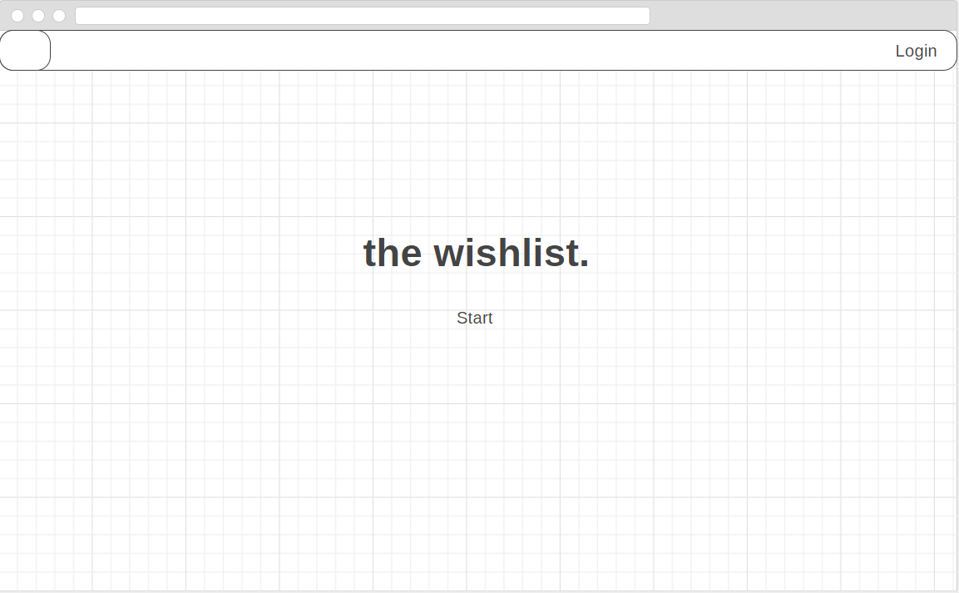
App Preview - Wireframe

Slide 9
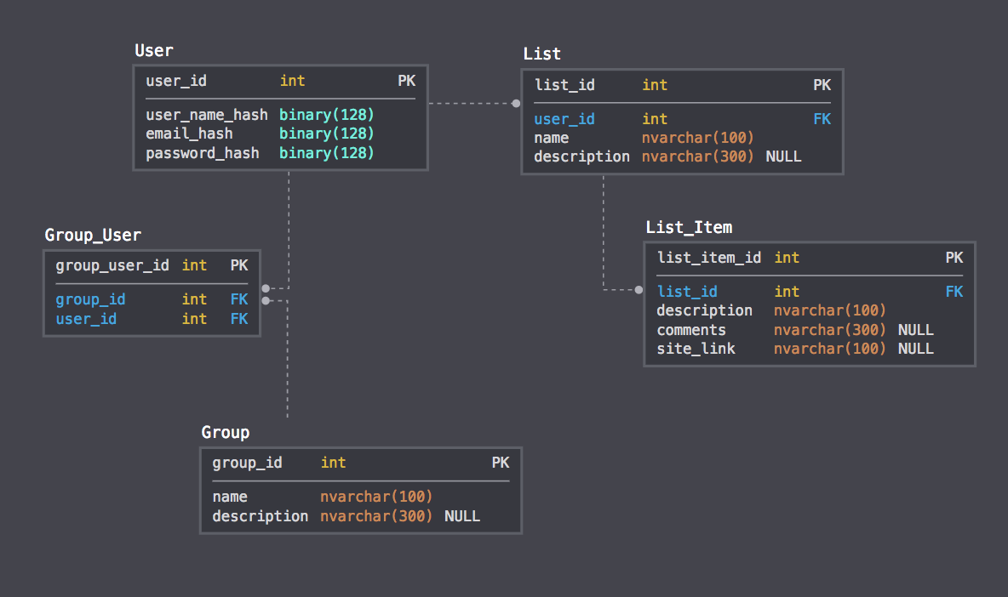
Schema
Users, lists, groups

